Slide 1
Welcome

Slide 2
V
V_{y}
V_{x}
V
m₁
m₂
Study of Projectile Motion.
V_{y}
V_{x}
V_{y}
V_{x}

Slide 3
Topic
Study of Projectile Motion
Submitted to
DR. KAMRUN NAHAR MUKTA
Assistant Professor
Dept. of FST AIUB
Presented by group: 4
S.M.Walid 23-50005-1
Kawser Khan 23-50192-1
Abir Tirtha Das 23-50228-1
Farhan Shahriar Joy 23-50306-1
Abu Bakkar Siddik 23-50049-1

Slide 4
Theory
Projectile motion
In Projectile motion a projected travels in a parabolic path.
This Curve motion alters due to air resistance.
In vertical the acceleration is always in uniform.
In horizontal case, the horizontal velocity is constant.
Helps to understand the basic concepts of Kinematics, uniform motion and other motion related equations.

Slide 5
Theory
Collision
The elastic collision occurred between smooth table and a marble ball.
Both the momentum and kinetic energy are conserved.
Impulse in any direction→
Impulse, J = ∆p = p_{f} - p_{i}
y
Line of impact
x
Fig 1.1: An elastic collision between a smooth table and ball.

Slide 6
Apparatus
Marble,
Ramp,
Clamp,
Recording paper,
Carbon paper,
Meter Scale,
Weighing Scale.
Fig 1.2: A ramp with a marble ball

Slide 7
Procedures
The apparatus of this experiment was set up as the fig 3.3 shown.
Placed carbon papers on white papers to identify the collision points.
Determined H and h with meter scale.
After the collision we determined the average distance S₁ and S₂ as well as uncertainty S₁ and S₂.
We measured the mass of that marble is 5.8 gm.
Repeated the process 10 times and had recorded the data
Every time the total mass is constant.

Slide 8
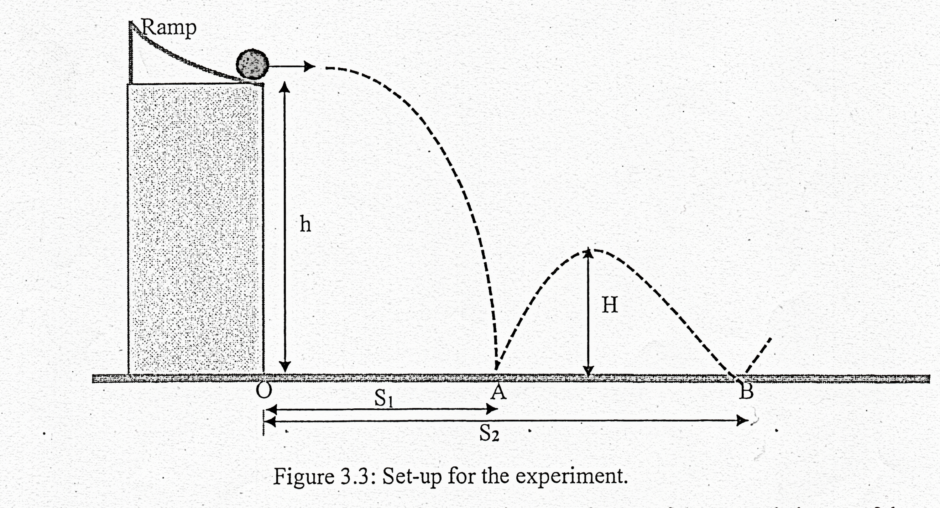
Experiment Setup

Slide 9
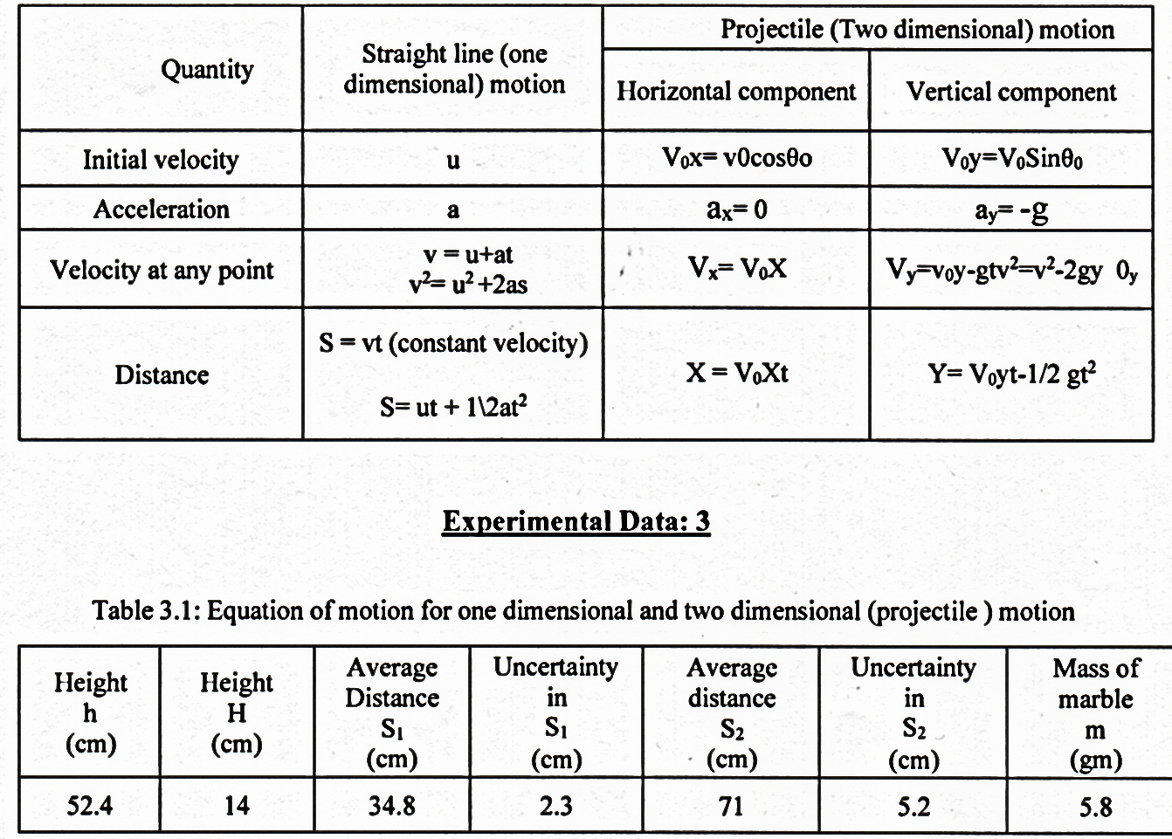
Analysis

Slide 10
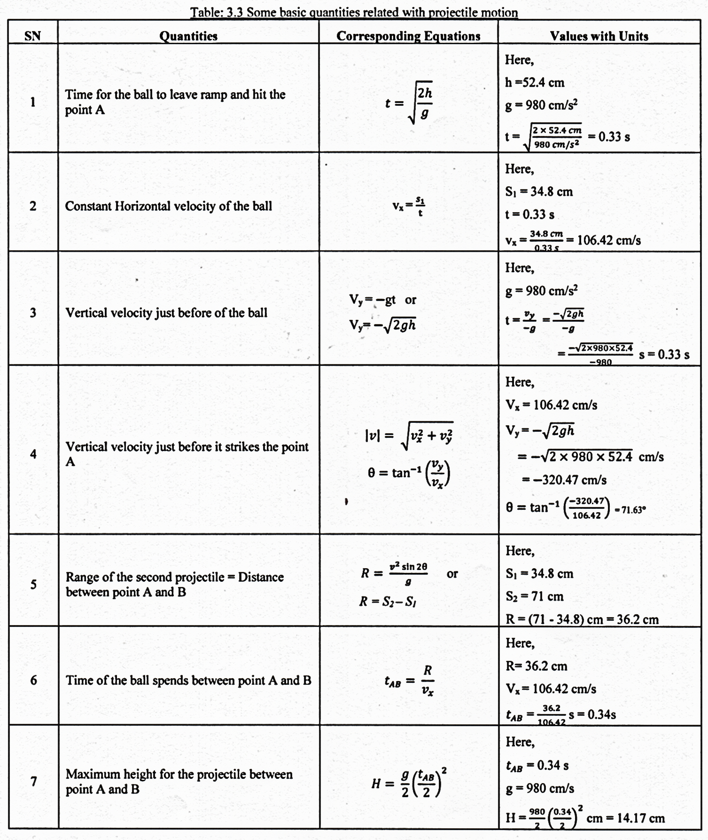
Result

Slide 11
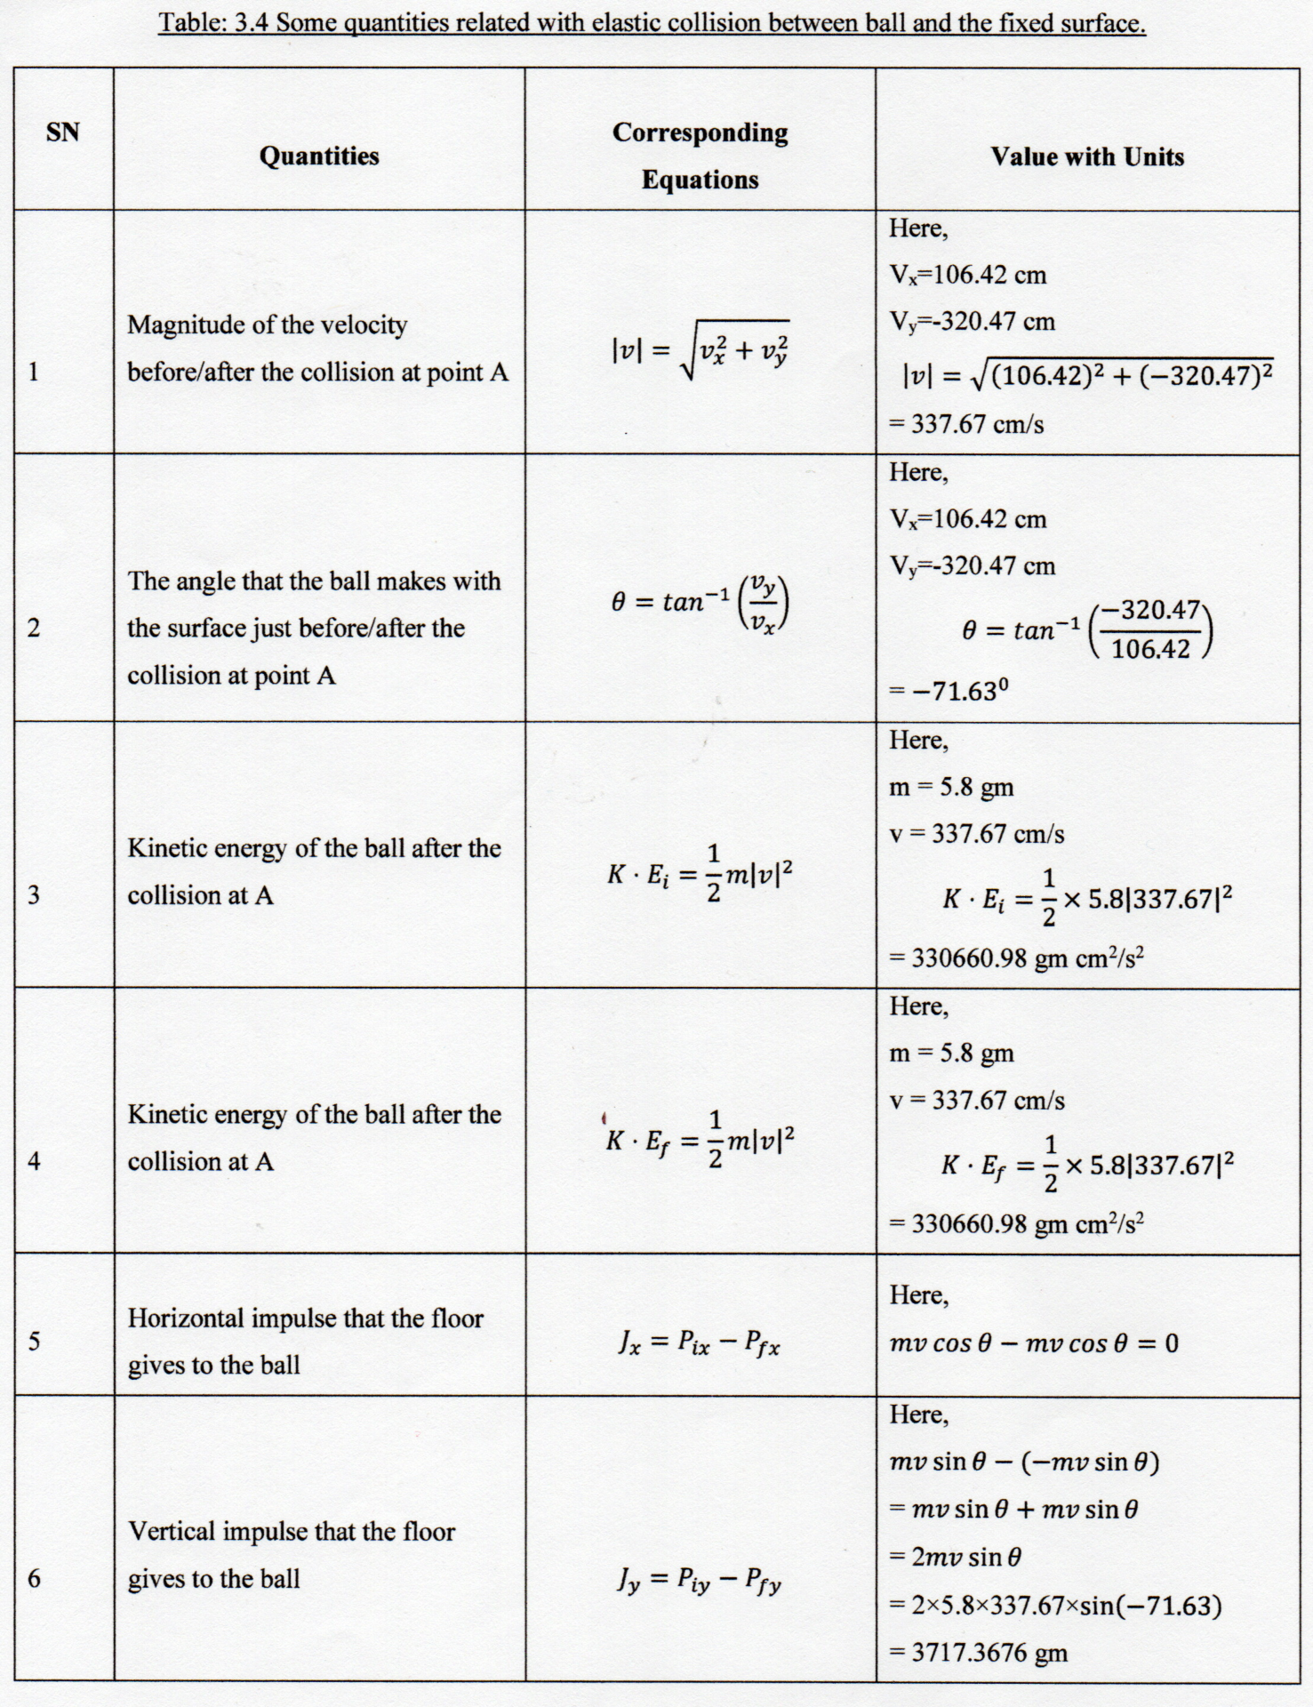
Result

Slide 12
Conclusion
The kinetic energy of the ball before the collision at A is equal to the Kinetic energy of the ball after the collision at A.
Meanwhile, the energy is conserved.

Slide 13
Discussion
We considered the surface of the table is smooth. But the surface of the table was not smooth enough.
Air resistance might be a cause.
Friction in ramp for marble might be slow down the actual speed of that marble.
The Meter Scale reading points was not clear.

Slide 14
Thank You

